Slide 1
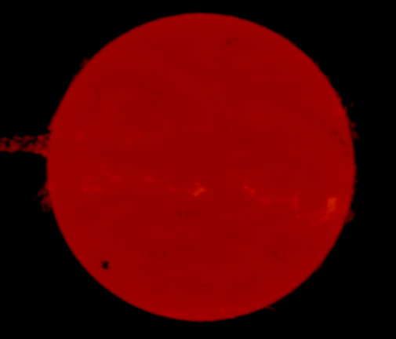
Radio

Slide 2
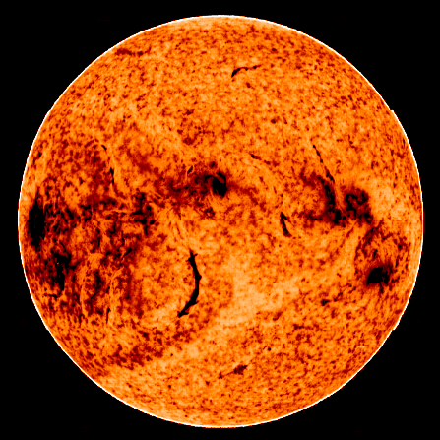
Infrared

Slide 3
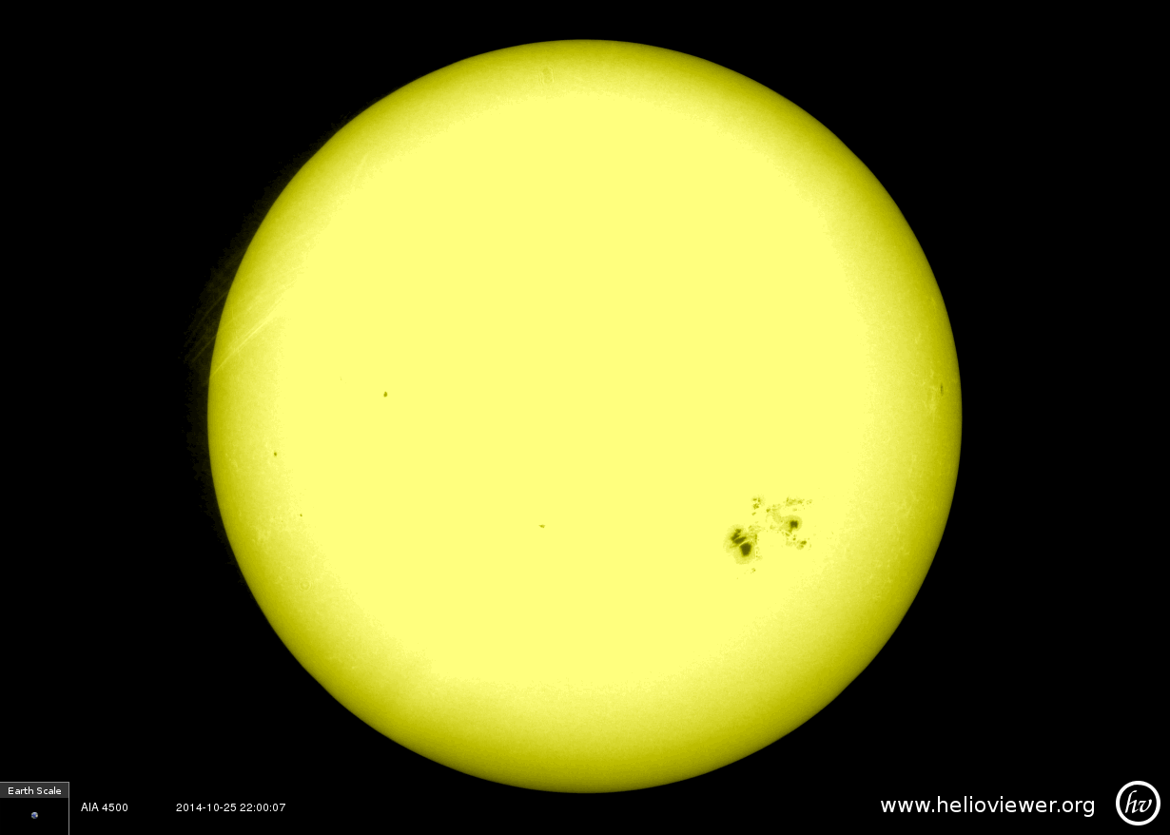
Visible

Slide 4
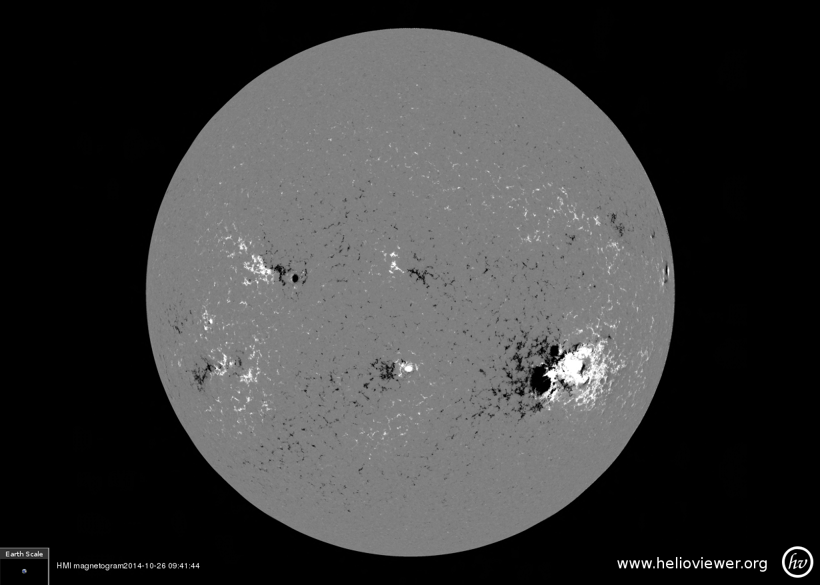
Magnetic field

Slide 5
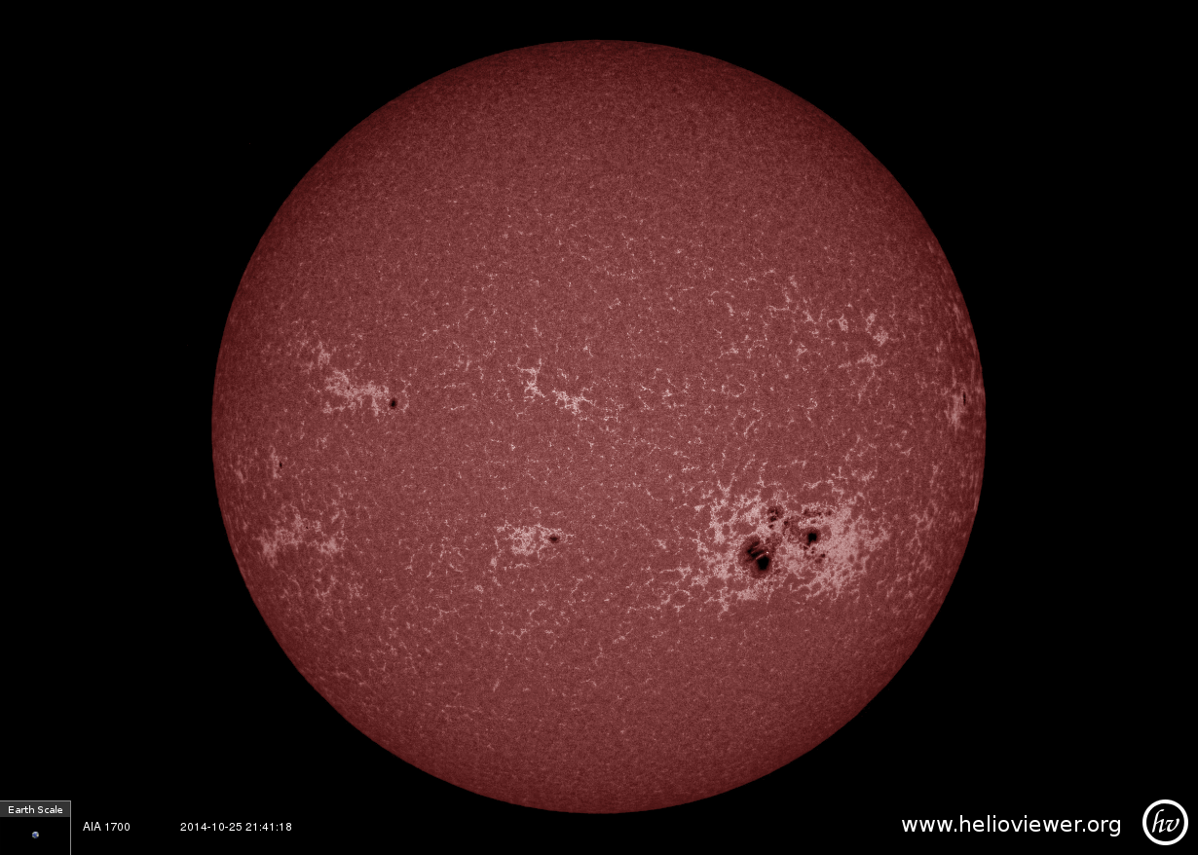
Far Ultraviolet

Slide 6
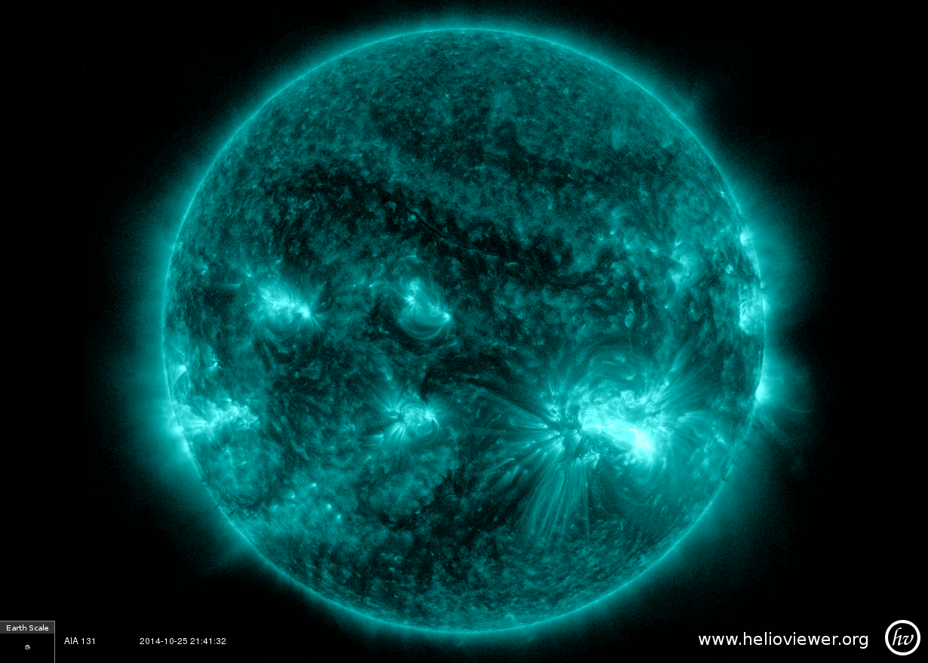
Extreme Ultraviolet

Slide 7
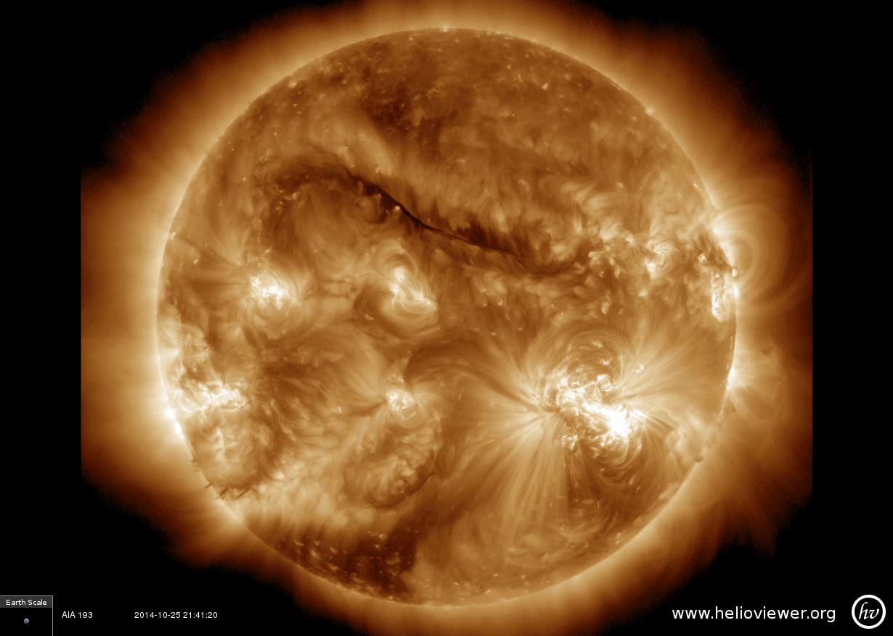
Extreme Ultraviolet

Slide 8
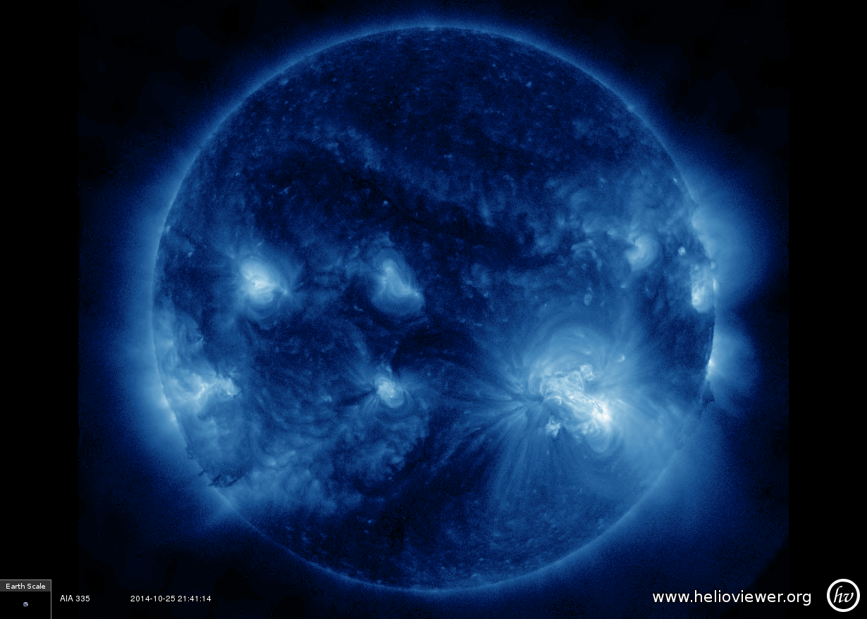
Extreme Ultraviolet

Slide 9
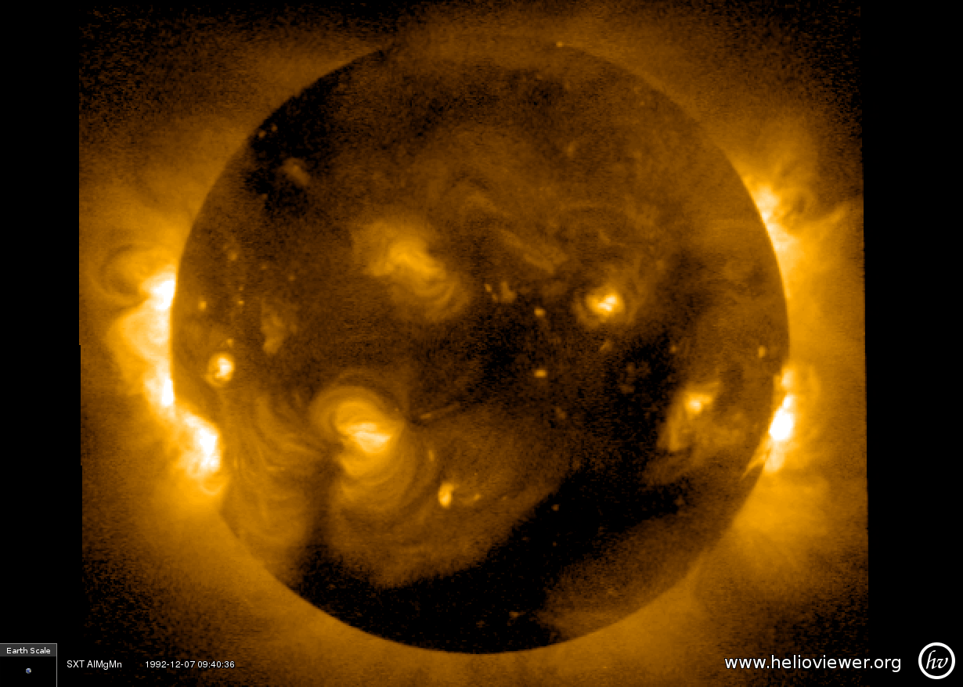
X-rays

Slide 10
Instructor notes
There is one picture of the Sun in all wavelengths except:
  Gamma rays – there are no images of the full Sun in gamma rays available.
  Extreme Ultraviolet – there are three different EUV pictures because this is the range where the Sun is most interesting, and can look very different within just this part of the EM spectrum.
The magnetic field image is an image of the Sun’s magnetic field at the photosphere (same layer as the visible image of the Sun in this packet). A region of black and white close together indicates a Sun spot, with magnetic loops going from white to black.
Compare the visible, magnetic field, and EUV images. They are all taken at the same time on the same day. Can you pick out the big active region in the bottom left quadrant? (Note: radio, infrared and X-ray images are not from the same day).
Since we cannot see most of the EM spectrum with our eyes, scientists apply false color to images of different wavelengths in order to make features stand out clearer, and to tell the different wavelengths apart. The Sun is not actually colored as it appears here – this is just using light as a tool.
These images were gathered using the www.helioviewer.org website (you can create your own images there too!) using data from the Nobyama Radio Heliograph (radio), National Solar Observatory (infrared), Solar Dynamics Observatory (visible, magnetic field and EUV) and Yohkoh (X-ray).

